Slide 1


book a
class
loner pups
PREPARED BY

Slide 2










CADETS
Cadets need tiggers for their projects
problems
SUBJECTS
So many subjects that we should understand to do one project
PEDAGOGY
This method still can be explored by other methods

Slide 3

CADETS
something that trigger cadets push their limits.
what we
SUBJECTS
need?
clear guidance doing the projects.
PEDAGOGY
more medium to explore this method.

Slide 4


book a
class
cadets
This is an app that helps
doing their part as a
or as a
teacher
student

Slide 5
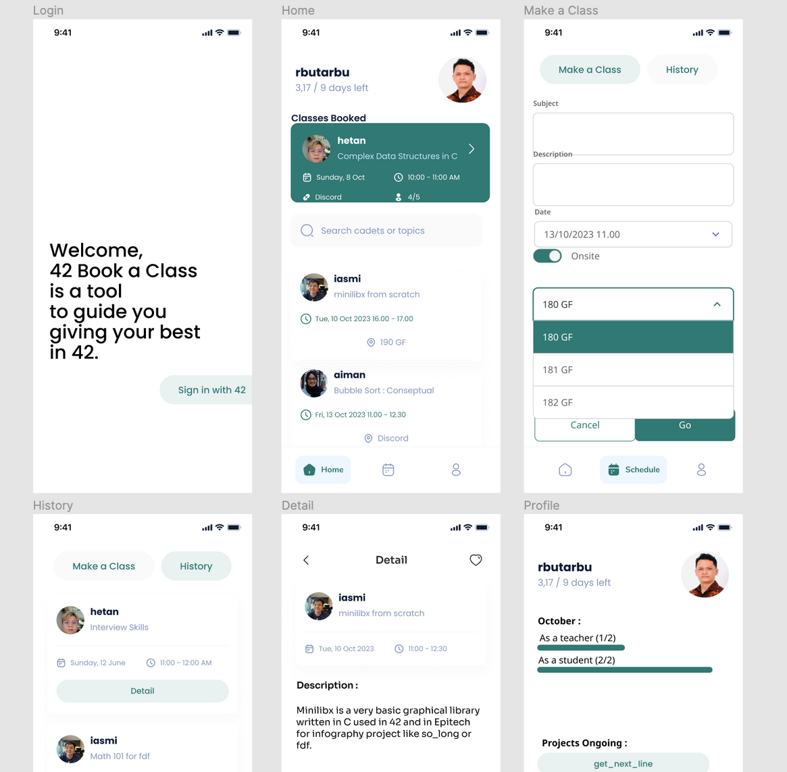
Front-end with flutter so we can deploy on several platforms.
Back-end with node-js.
RDBMS using sqflite.

Slide 6
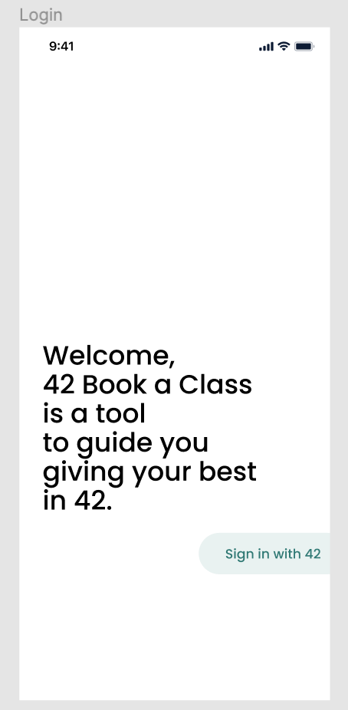

It's a clever protocol that lets external apps request permission to your private 42 account details through tokens, which can be customized to specific data types and revoked by you anytime. So, no more fretting over password sharing - OAuth2's got you covered!
Use the OAuth2 that available in 42 APIs

Slide 7
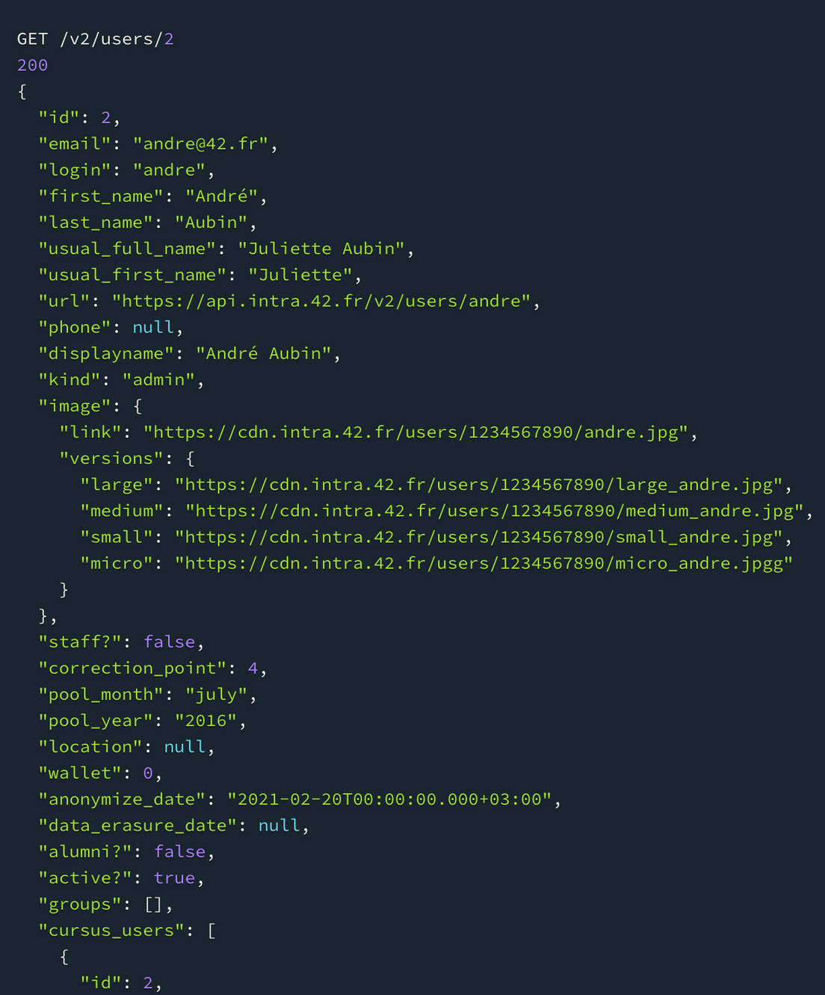
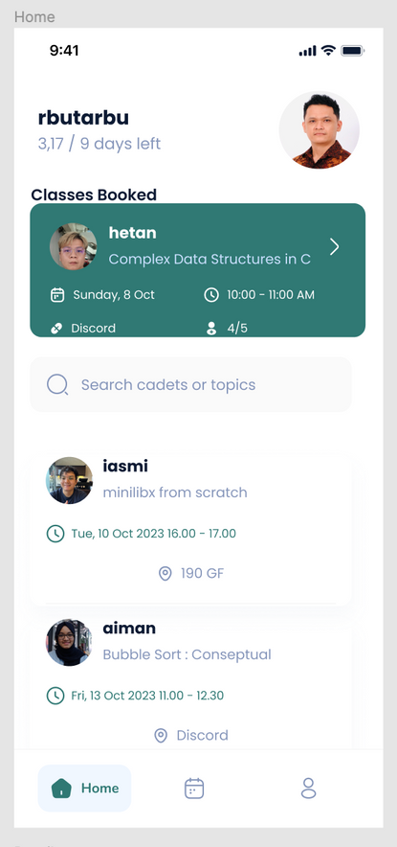
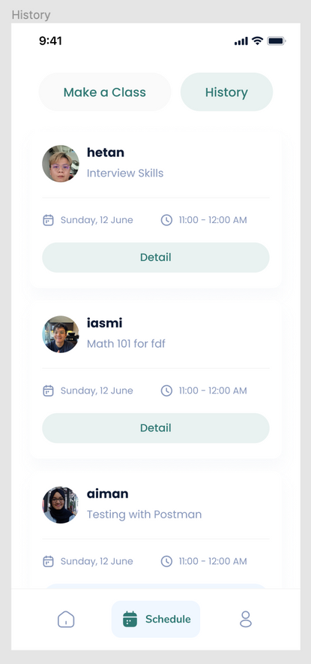
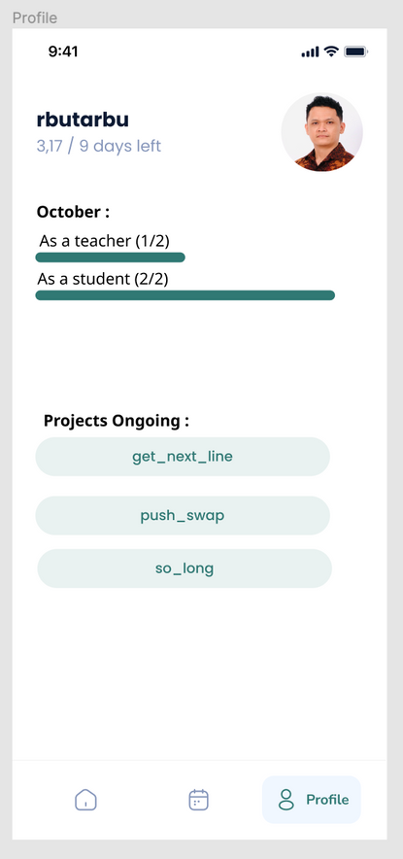

Slide 8
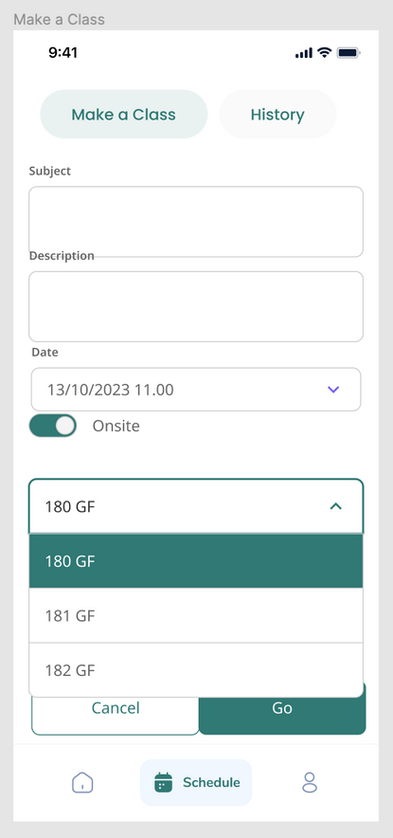
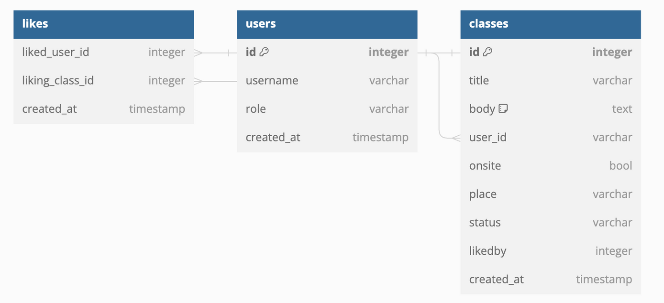

Slide 9


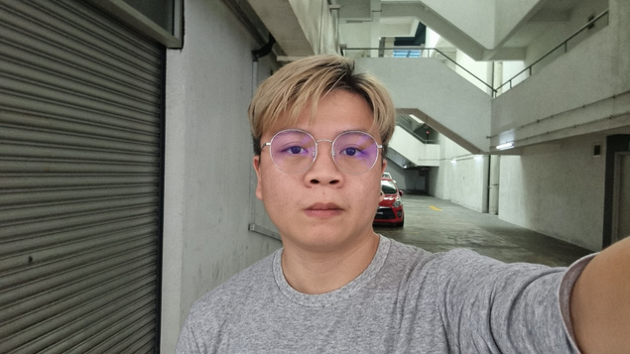
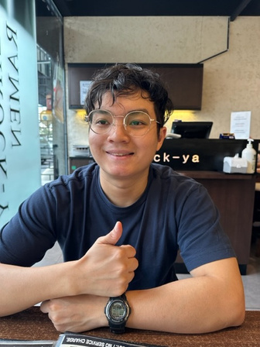
THE
loner pups
team
RBUTARBU
HETAN
IAZMI

